Slide 1
Freshco Hypermarket Delivery Service Analysis
Optimizing Delivery Operations and Enhancing Customer Satisfaction

Slide 2
Introduction
• Freshco Hypermarket launched home delivery in 2021 to enhance customer convenience.
• Data captured includes:
- Order Details (timestamps, user IDs, locations).
- Product Information and Delivery Partner Timelines.
- Order Status and Customer Feedback.
- Financial Metrics (revenue, discounts, delivery charges).
• Analysis Focus Areas:
1. Delivery Performance Analysis.
2. Customer Satisfaction.
3. Revenue and Cost Analysis.
4. Operational Insights.

Slide 3
Objective
The analysis aims to provide actionable insights to:
• Optimize delivery operations.
• Improve customer satisfaction.
• Enhance financial performance.
• Drive informed decision-making for future growth strategies.
Goal:
Strengthen Freshco's position as a customer-centric retailer and ensure sustainable business growth.

Slide 4

Order Level Analysis Report
Overview of Delivery Order Patterns

Slide 5
Key Findings
1. Afternoon slot dominates order volume, late night exhibits low activity.
2. Prominent regions like HSR Layout generate high order volumes.
3. High delivery charges during late night discourage orders.
4. Discounts are used effectively in Evening slots and high-demand areas.

Slide 6
Order Distribution & Insights
1. Afternoon: 5924 orders (Most Active)
2. Late Night: 1589 orders (Least Active)
3. HSR Layout: Highest orders in September
4. Late Night charges (15%-16%) are discouraging orders.

Slide 7
Recommendations
1. Boost late-night orders with higher discounts.
2. Optimize delivery charges by reducing late-night fees by 5%.
3. Focus on high-potential areas like HSR Layout.
4. Expand services in low-activity areas like JP Nagar.
5. Optimize discounts for underperforming regions and time slots.

Slide 8
Conclusion & Next Steps
1. Monitor promotional campaigns for late-night orders.
1
2. Analyze feedback after reducing late-night delivery charges.
2
3. Study low-activity regions to identify barriers and opportunities.
3

Slide 9

Completion Rate Analysis Report
Summary of Performance and Key Insights

Slide 10
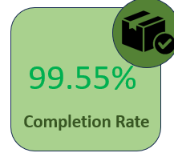
Overall Completion Rate
Overall Completion Rate: 99.55%
Key Insight: High operational efficiency and reliability.

Slide 11
Slot and Weekday Performance
• Weekday Variations:
- Friday reports the lowest completion rates.
• Slot-wise Performance:
- Late Night slot has slightly lower rates overall.
Key Insight: These periods require operational review.

Slide 12
Drop Area and Product Analysis
• Drop Area:
- Most areas have 100% completion rates.
- Indiranagar and Viveka Nagar have slight dips.
• Product Quantity:
- Slight dip for orders with 1-5 products.
Key Insight: Address logistical challenges in specific areas.

Slide 13
Recommendations
Investigate Late Night and Friday, Saturday performance.
Optimize drop area performance in Indiranagar and Vivek Nagar.
Refine order fulfilment processes.
Enhance delivery partner training and incentives.
Leverage data analytics and customer feedback for improvements.

Slide 14
Customer Analysis Report
Summary of Trends and Insights

Slide 15
Key Highlights
High completion rates across organic and Facebook acquisition sources.
Organic and Google channels yield the highest LTV.
Afternoon, Morning and evening slots receive higher order ratings.
January customers show peak LTV and revenue per order.
Balanced pricing enhances order ratings.

Slide 16
Customer Acquisition and LTV Insights
• Organic and Google channels: Highest LTV (₹12,479 and ₹12,204).
• Instagram: Lowest LTV (₹2,870) and Avg Revenue (₹ 301).
• January customers: Peak LTV (₹14,000) and revenue per order (₹360).
Key Insight: Organic and Google channels foster long-term value.

Slide 17
Revenue and Order Satisfaction Trends
• Highest revenue per order: Snapchat (₹344) and Google (₹343).
• Morning, Afternoon and evening slots: Best order ratings.
• Higher orders (21–25 items): Highest ratings.
Key Insight: Strategic focus on high-performing slots and smaller orders improves satisfaction.

Slide 18

Recommendations
Optimize organic and Google acquisition strategies.
Reassess Instagram and offline campaigns.
Focus on morning and late-night slot improvements.
Balance delivery charges and discounts.
Implement loyalty programs targeting high-LTV customers.

Slide 19
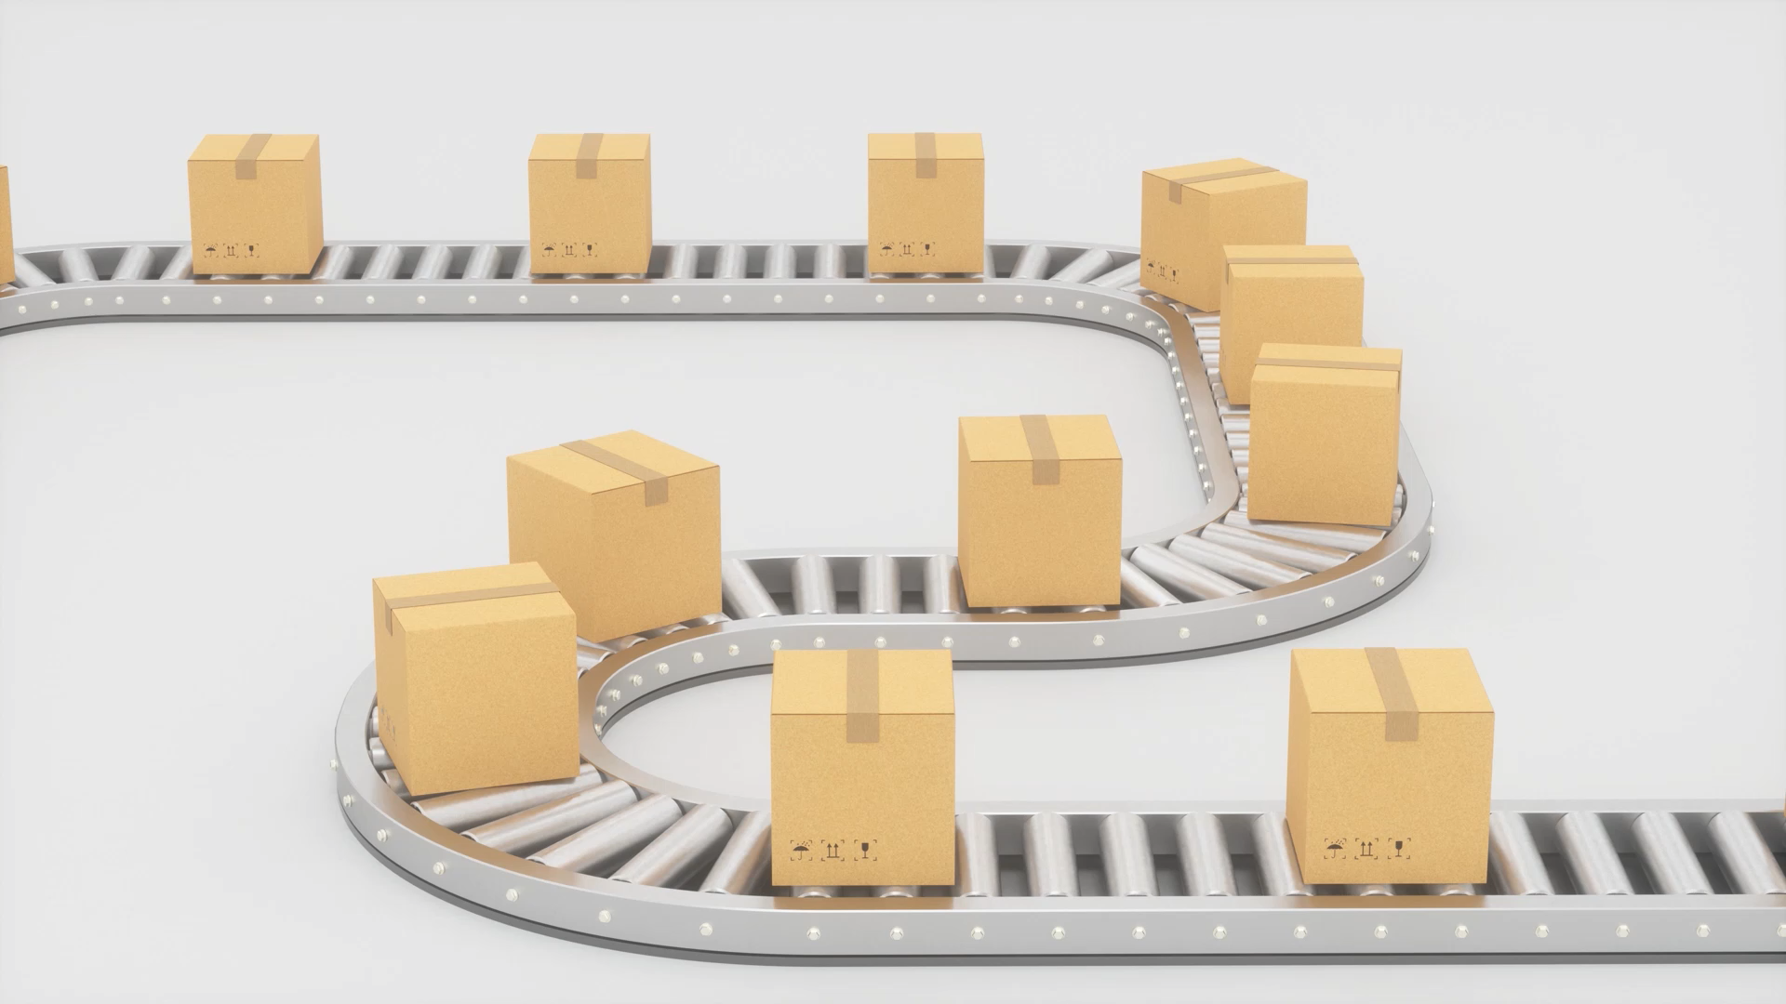
Delivery Level Analysis Report
Key Challenges and Opportunities

Slide 20

Key Highlights
Afternoon and Evening slots have the highest delivery times.
Weekdays outperform weekends in delivery efficiency.
April and May show peak delivery delays.
Certain drop areas face logistical challenges.

Slide 21
Delivery Analysis by Drop Area and Time
• Night and Late Night slots: Best performance with low delivery times.
• Afternoon and evening slot: Worst performance with highest delivery delays.
•The Drop area “Mahadevapura” has highest delivery time.
• Wilson Garden and Cox Town Areas have best performance in delivery.
Key Insight: Optimize Afternoon and Evening slot operations.

Slide 22

Delivery Analysis by Drop Area
• High Variation:
- Certain areas consistently face longer delivery times.
• Possible Causes:
- Traffic congestion, resource allocation, or geographical challenges.
Key Insight: Address area-specific bottlenecks for improved performance.

Slide 23
Recommendations
Investigate and resolve delays in Afternoon and Evening slots.
Use route optimization software to improve efficiency
Add delivery capacity during peak times
Provide accurate delivery updates to customers
Regularly monitor KPIs to measure and improve performance.

Slide 24

Strategic Recommendations
Optimizing Freshco Hypermarket's Delivery Performance

Slide 25
Key Strategic Recommendations
1. Boost Late-Night Orders:
- Higher discounts and reduced delivery charges for late-night slots
- Optimize delivery routes and increase resources during these hours.
2. Enhance Efficiency in Key Areas:
- Address logistical challenges in Marathahalli and Bellandur.
- Collaborate with local delivery partners.
3. Leverage High-Performing Channels:
- Focus on organic and Google channels.
- Launch loyalty programs for high-value customers.

Slide 26
Operational Enhancements & Final Remarks
1. Optimize Discounts and Delivery Charges:
- Target discounts for underperforming regions and slots.
- Align delivery charges with perceived value.
2. Address Operational Inefficiencies:
- Improve delivery during peak slots and weekends.
- Use predictive analytics to anticipate demand.
Final Remarks:
• Enhance customer satisfaction through feedback and real-time tracking.
• Strengthen Freshco's market position and ensure long-term growth.

Slide 27

THANK YOU

